Slide 1
The Working Time Agreement –Empowering Members to Manage Workload

Slide 2
Teacher Wellbeing: who cares?
“There is a growing recognition that for teaching and learning to be at its most effective, teachers should have high levels of well-being, self-efficacy, and confidence.” OECD
“We have a shared desire to reduce the workload of teachers…We would propose to work with the professional associations and Education Scotland to develop a new programme of professional learning for teachers which is focused on wellbeing…” John Swinney, letter outlining terms of pay offer.
“Create and sustain appropriate working relationships with all staff, parents and partner agencies to support learning and wellbeing, taking a lead role when appropriate.” GTCS SfR
Notes:
Intro to reiterate the importance of teacher wellbeing.
Who cares- international and national attention on this topic. The profession cares as evidenced by the inclusion of attention to wellbeing within the Professional Standards. (This reference is likely to be strengthened as an outcome of the current review of Professional Standards.)

Slide 3
Why care?
Increasing expectations of the profession + Diminishing resources + Rising workload
76% of respondents to a recent EIS member survey reported that they felt stressed “frequently” or “all of the time” within their jobs
Poor work-life balance
Poor mental and physical health
Disempowerment
Negative impact on teachers in personal and professional lives
Unsustainable
Negative impact on young people’s learning experience
Need to ensure and maintain one’s own wellbeing as a professional as well as a personal one.
Notes:
Relationship between wellbeing, resource and workload.
Personal and professional damage.
Unsustainable.
And as well as there being a personal responsibility for self-care (which teachers often neglect) there’s a professional responsibility as articulated within the Standards to consider the wellbeing of self and other colleagues.
And of, course, unions care. EIS cares. Member wellbeing of paramount importance to us.

Slide 4
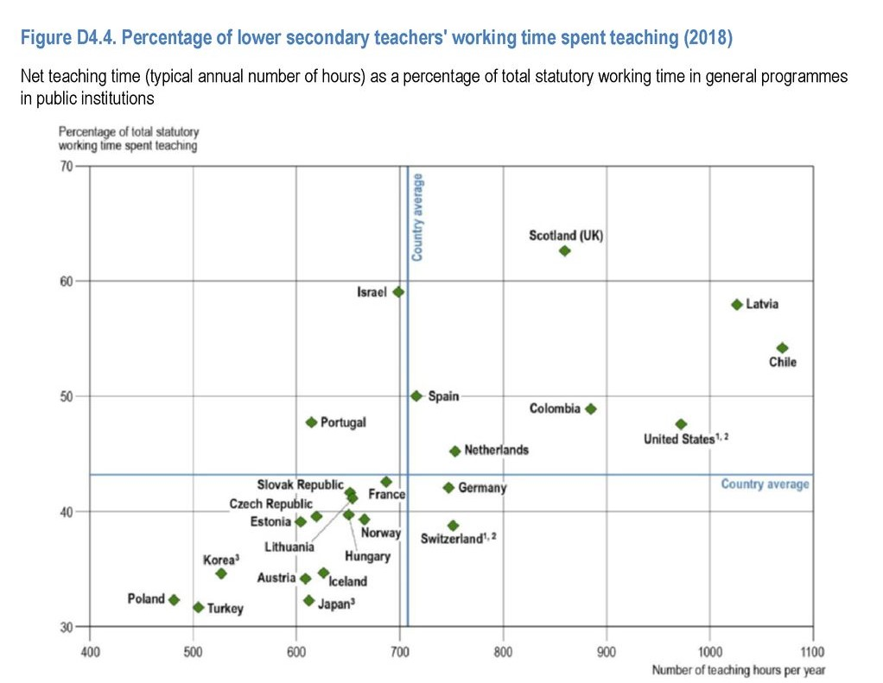
Scotland: OECD Outlier
Notes:
This slide shows that Scotland’s teachers teaching time is amongst highest in OECD – reinforcing the need for the TTTW Campaign.
OECD Also shows that Scotland’s education system could work differently and that things don’t have to be like this.
Chart is from OECD Education at Glance (2018) OECD. Scotland the highest % working time teaching in the OECD survey. Scotland has the 5th highest number of teaching hours.
The importance of international comparisons – especially OECD – to Scottish Government.
Time spent teaching per year (hours) Scotland 855 (P,S) OECD 766 (P) 700 (Lower Sec)
Average Class (P) Size UK 28 OECD (21)

Slide 5
Introduction
WTA at school level- collective agreement reached
between trade union(s) and Head Teacher.
Must take account of LNCT advice-
https://www.snct.org.uk/lnctAgreements.php
Binding on all members of teaching staff in the
establishment, including promoted post holders.
Signed-off as agreed by Rep and Head Teacher.
Notes:
Use link to demonstrate where to find LNCT agreements.

Slide 6
What is excessive workload?
Anything that makes it impossible for teaching staff to complete their duties within the 35-hour week *
Climate of collegiality must underpin enhanced professional role of teachers
Due regard to workload and contractual obligations to allow time for core role as leaders of learning
*SNCT Statement of Teacher Professionalism (Part 2: Appendix 2.6)
Notes:
http://www.snct.org.uk/library/2103/Part%202%20Appendix%202.18.pdf
Emphasise that there is also a huge amount of guidance around controlling workload (negotiated by EIS), at both national and local level, that as we move forward with the campaign to reduce excessive workload, it is about using the existing guidance and mechanisms. We have a contract for a 35 hour week!

Slide 7
Concepts of Time
35 hour working week - 22.5 hours class contact maximum
7.5 hours (1/3 class contact time)for personal planning and preparation
5 hours weekly for collegiate work
195 hours annually (39 working weeks x 5 hours)
Part-time staff on pro-rata basis

Slide 8
Core Collegiate Activities
Additional Time for Preparation and Correction
Parents’ Meetings (prep, travel time, follow-up time)
Reporting to Parents
Formal Assessment
Planning
Staff Meetings
PRD
Trade Union Meetings
Flexibility (EIS recommends at least 20 hours)
* Additional Supervised Pupil Activity
Notes:
Additional Supervised Pupil Activity- EIS advice is that his does not appear in a WTA. If teachers choose to attend a school fair or run an after-school club that can be their choice but it should not be a demand for all teachers.
Staff meetings should not be happening every week.
TU meetings-good practice would be about one a term. Roughly 3 hours.

Slide 9
School Negotiating Group
10 staff or less – everyone in!
Management Side –max 3 SMT
Teachers’ Side – largest union in establishment nominates their Convenor
Max number of members on Teachers’ side 5 – should reflect balance of union membership
Convenor of Teachers’ Side determines its representation on the group

Slide 10
EIS School Branch Committee: WTA Preparation
Never just agree to last year's WTA.
Professional Audit – Evidence-based assessment of time taken by teachers to complete each collegiate activity in the year – use a spreadsheet or pro-forma to ask/survey members (individual, stage or dept returns).
Outcome returns from Professional Audit used by EIS Branch to decide time demand for each activity.

Slide 11
The School Improvement Plan and anything new
SIP priorities should be identified and time-costed in advance of negotiating WTA.
If any new systems (IT, reporting etc) or courses/schemes of work are to be introduced, plan that these will take more time to embed.
No new systems or course/schemes of work should be introduced throughout session; they will have to wait until the following session.

Slide 12
Planning the Calendar
The Calendar must be completed alongside the WTA.
Insert indicative times (max 5 hours per week) for statutory duties (parents’ meetings, reporting, etc.) and working backwards add other events in Calendar. A spreadsheet can be useful to calculate hours.
Make sure hours reflect time taken- preparation, reading, follow-up, etc.
Based upon learning and teaching needs insert indicative times for SIP activities.
Review activities carried out last year and prioritise any time left.

Slide 13
Developing Issues and Remodelling
Branch WTA committee will need to “reschedule” parents’ meetings and other professional activities if need be.
Prioritisation will mean some activities cannot take place unless time is freed up.

Slide 14
Remember…
Dates and times of meetings must be agreed and take account of part-time staff.
Address SIP priorities within the calendar.
Present stress point issues (transition, GIRFEC, ASN, etc) with narrative proposals particularly when indicative time allocations do not meet the needs of specific teachers.

Slide 15
Branch Decision-Making
Present fleshed-out proposals to branch meeting
Revise/amend as per branch decision
Advise other TUs of EIS position
Present proposals to management for negotiations
Take outcome of negotiations back to branch for decision
EIS Rep signs off agreement with HT

Slide 16
Hit a problem? Failure to agree
The role of LNCT Joint Secretaries at local level.
Status quo ante applies.
The role of the SNCT at national level.

Slide 17
Final thoughts...
The WTA is a negotiated process.
The WTA is a contractual obligation; it is contractually binding on the Council, as employer and on all teaching staff.
If there is no calendar, there is no agreement.
Get in touch with your Organiser for support and/or further branch training.

Slide 18
What makes a good WTA?
Completed WTA takes account of LNCT advice.
WTA is a collective negotiation beginning with branch discussion led by EIS Rep.
WTA is an inclusive process where all teaching staff have opportunity to participate.
Evidence gathered throughout year forms basis for negotiations.
Accompanied by calendar that details hours spent on activities.
Detailed breakdown of hours for each activity.
Use narrative proposals to meet the needs of specific teachers.
Takes account of part-time staff on a pro-rata basis.
Has at least 20 hours of flexibility.
WTA signed off by HT and EIS Rep.
Returned within time outlined in LNCT agreement.

Slide 19
Over to you…
Identify excessive workload not addressed by WTA hours and plan to discuss at additional in-set day.
If additional in-set days have been used successfully to identify excessive workload, discuss as a Branch how solutions will be taken forward.
Find out about and become involved with your School Negotiating Committee or Consultative Group.
Engage with a regular audit process by tracking time spent on activities.
Engage in regular conversations about workload with your colleagues.
Make the WTA a visible and important document in your school-display in classrooms, staffrooms and staff bases.
Ask your Organiser for branch training and remember, knowledge is power!

